Slide 1
MARKETING ANALYTICS MILESTONE -2
MOHAMED RIFAZ ALI
APRIL’22

Slide 2
Agenda & Executive Summary of the data
Problem statement
A Grocery Store shared the transactional data with you. Our job is to
identify the most popular combos that can be suggested to the
Grocery Store chain after a thorough analysis of the most commonly
occurring sets of menu items in the customer orders. The Store
doesn’t have any combo meals. After performing Market Basket
Analysis, we will suggest the Grocery store with combo meals, dicount
offers and combos.

Slide 3
Exploratory Analysis
About Data
The grocery store has provided the transaction data's of 2018, 2019 and 2020.
The data's of “Date” column in 2 different formats. By default,
KNIME has the mechanism to detects on its own & bring the Date field to the one common format. Whereas, in Tableau used for EDA & Visualization, it treats incorrectly. So, create a new calculated field and bring the both the dates to the common format, by replacing the ‘-’ with ‘/’ & convert into Date Format.
DATE(DATEPARSE ( "dd/MM/yyyy", REPLACE([Date1],"-","/") ))
The Grocery store has the transaction data's only from January to September(Q1,Q2,Q3) and not having the records for Q4 for 2018 and 2019. For the year 2020, it has the records only for January & February.
There are total of 20641 records and no missing/anomalies present in the provided dataset.

Slide 4
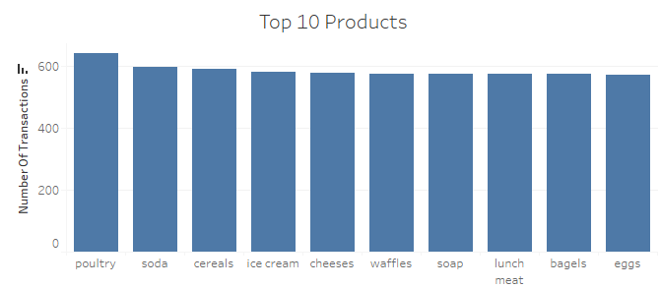
There are about 1139 unique transactions in the dataset.
There are 37 unique products available in the Grocery store.
Top selling products
Poultry is the top selling product in the store.
There is a consistency in buying the other products as well. No major ups and downs on the transactions on the rest of the products, a good indicative of items are not liquidating in the store.

Slide 5
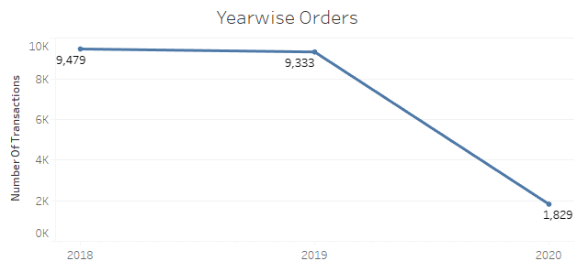
Year wise Transactions
The year 2018 marginally have high orders compared to the year 2019. For 2020, the data provided is just for 2 months & not a good measure to compare it with previous years.

Slide 6
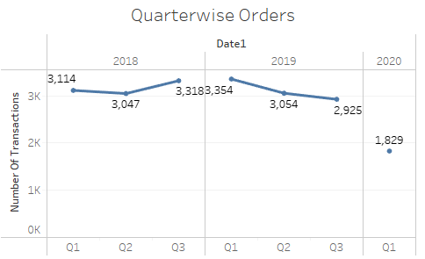
Quarter wise Transactions by Year
Interesting pattern of Q1, Q3 between 2018 & 2019 is reversible.
In Q1 of 2019, there is an high number of transactions comparatively with 2018 and for Q3 it is vice-versa.

Slide 7
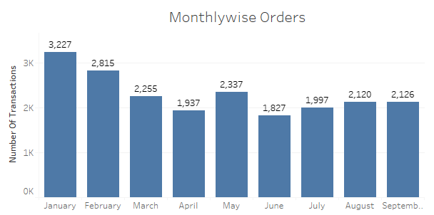
Monthly wise Orders
There are good number of orders beginning of the year especially
January, February and May. When the holiday seasons are over, customers are likely to buy more grocery items.
We do not have the data's for Q4 thus we cannot comment on that.

Slide 8
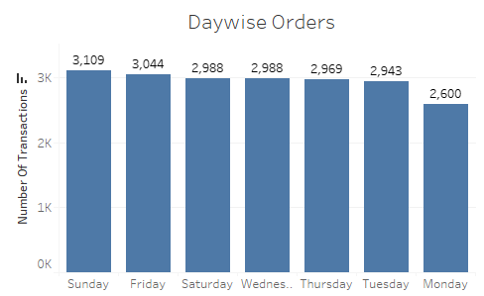
Day wise Orders
As expected, beginning weekends(Friday. Saturday. Sunday), quite good number of purchase made by customers.
For other weekdays, transactions are not too bad.
On Monday, the number of orders relatively less with rest of the days.

Slide 9
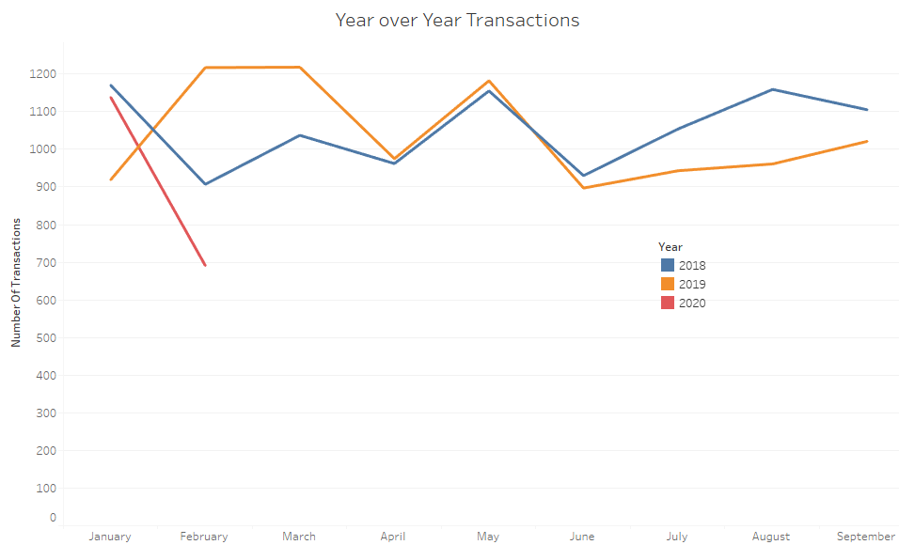
Year over Year By Months
Based on the pattern, after Q3 of 2018, there is a quite good number of items sold in Q1 of 2019. Whereas after Q3 of 2019, sales of Q1 2020 is continue to decrease which needs to be investigate.
Q1,Q3 of 2018 orders are opposite to Q1,Q3 of 2019 orders.
There is a perfect seasonality on April, May & June between
2018 & 2019.

Slide 10
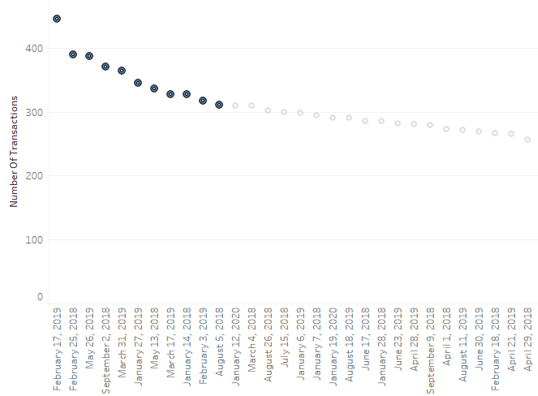
Week wise from high to low
Mostly, the top 10 weeks are in the months of January, February or May. Also, observed some good purchases during August, September as well.

Slide 11
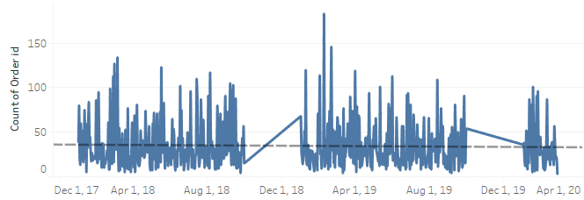
Entire Transaction Data
There is no trend present in the dataset. However, beginning 2020, there is a decrease in trend, but we need more data's to conclude on the fact.
Observe, there is a slight seasonality during February, April, May and June.

Slide 12
Market Basket Analysis
What Is Market Basket Analysis & its use?
Market Basket Analysis is a technique which identifies the strength of association between pairs of products purchased together and identify patterns of co-occurrence. A co-occurrence is when two or more things take place together.
Market Basket Analysis creates If-Then scenario rules, for example, if item A is purchased then item B is likely to be purchased. The rules are probabilistic in nature or, in other words, they are derived from the frequencies of co-occurrence in the observations. Frequency is the proportion of baskets that contain the items of interest. The rules can be used in pricing strategies, product placement, and various types of cross-selling strategies.

Slide 13
How Market Basket Analysis Works(Association Rules)?
In order to make it easier to understand, think of Market Basket Analysis in terms of shopping at a supermarket. Market Basket Analysis takes data at transaction level, which lists all items bought by a customer in a single purchase. The technique determines relationships of what products were purchased with which other product(s). These relationships are then used to build profiles containing
If-Then rules of the items purchased.
The rules could be written as:
If {A} Then {B}
The If part of the rule (the {A} above) is known as the antecedent and the THEN part of the rule is known as the consequent (the {B} above). The antecedent is the condition and the consequent is the result. The association rule has three measures that express the degree of confidence in the rule, Support, Confidence, and Lift.

Slide 14
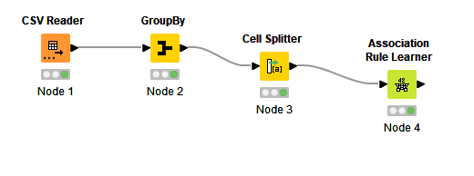
We used KNIME tool for the Market Basket Analysis to analyze the Grocery Store dataset.
To use the Association Rule Learner node in the KNIME tool for Market Basket Analysis, the data's must be passed as in the form of set like [item1,item2, item3,item4….. ]
So, first we need to group by Order id & using the cell splitter node, we convert the items to ‘set’ by removing the duplicates may present in the single transaction.
KNIME Workflow Image

Slide 15
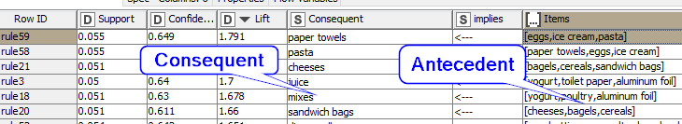
For example, let's consider in our case.
‘Antecedent’ item for one of the basket is eggs, ice cream and
pasta. ‘Consequent’ (recommended) item for this basket is paper towels.
Based on the products bought in Grocery store such as eggs, ice cream, pasta and paper towels in a single transaction. The transactions are then gathered and analyzed to identify rules of association.
We’ve got the good strength of the association when we set the threshold values for ‘Support’ is 0.05 and for the confidence is 0.5 (50%).

Slide 16
An item set satisfies minimum support if the occurrence frequency of the item set is just 0.05(5%).
A confidence of 0.5 in the above example would mean that in 50% of the cases where eggs, ice cream & pasta were purchased, the purchase also included paper towels. For the product recommendation in Grocery store scenario, a 50% confidence may be perfectly acceptable.
In our example, ‘paper towels’ is the recommended item and we cannot expect the same the Association ruler mechanism to suggest eggs/ice cream/pasta when ‘paper towels’ is in antecedent side. Because, this mechanism uses the conditional probability.
i.e., P(A|B) may not be necessary be equal to P(B|A)

Slide 17
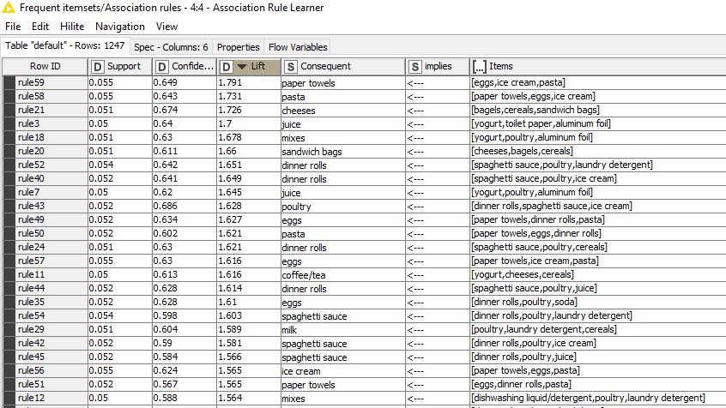
Grocery Store Association Identified
KNIME Association Rules Output sorted in descending order of Lift

Slide 18
The best way to look at the report is to sort the report based on ‘Lift’ measure.
Eggs, ice cream, pasta, paper towels is most frequent items present in the basket with the lift measure of 1.791 and confidence of 64.9%.
Simplest Table Representation
I’ve considered the simple least basket from the transaction
to calculate the Support, Confidence and Lift Measures.
Antecedent – Cheeses, Ketchup
Consequent – Sandwich loaves

Slide 19
There are 1139 baskets in the table.
Lets do the analysis for the one Basket to understand the
measures.
Basket | products | How many baskets containing the product? (A&B) | Total # of Baskets (Total) | Support (A&B)/Total | Confidence (A&B)/A | Lift (Confidence/(B/Total)
1 | Cheeses, ketchup(A) | 183 | 1139
 | sandwich loaves(B) | 398 | 1139
 | milk >> cheese (A&B) | 94 | 1139 | 0.082528 | 0.513661 | 1.47

Slide 20
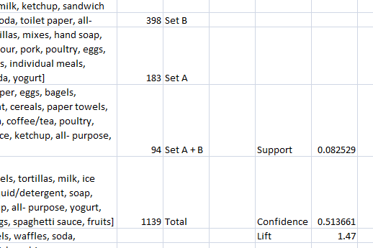
Copy the group by node results from KNIME and copy it into Excel & using the COUNTIFS formula in the formula bar, able to figure out the counts of the items.
Set A =COUNTIFS($A$1:$A$1139,"=*cheeses*",$A$1:$A$1139,"=*ketchup*")
Set B =COUNTIF($A$1:$A$1139,"=*sandwich loaves*")
Set A +B =COUNTIFS($A$1:$A$1139,"=*cheeses*",$A$1:$A$1139,"=*ketchup*",$A$1:$A$1139,"=*sandwich loaves*")

Slide 21
Support
Support is the evidence of how frequent an item appears in the
data given. The number of transactions that include items in the
{A} and {B} parts of the rule as a percentage of the total number
of transactions. It is a measure of how frequently the collection
of items occur together as a percentage of all transactions.
Support = (A + B)/Total
Support for Basket 1 = (Cheeses + Ketchup+Sandwich loaves)/Total
=94/1139=0.082528
Fraction of transactions that contain both A and B.

Slide 22
Confidence
Confidence is defined by how many times the if-then statements
are found true. The ratio of the number of transactions that
include all items in {B} as well as the number of transactions
that include all items in {A} to the number of transactions that
include all items in {A}.
Confidence = (A + B)/A
Confidence for Basket 1 = (Cheeses + Ketchup+Sandwich
loaves)/(cheeses + ketchup)
= 94/183 = 0.51366
How often items in B appear in transactions that contain A only.

Slide 23
Lift
It is the important measure of all & can be used to compare the
expected Confidence and the actual Confidence. Expected
confidence is the confidence divided by the frequency of B. The
Lift tells us how much better a rule is at predicting the result
than just assuming the result in the first place. Greater lift
values indicate stronger associations.
Lift= Confidence/(B/Total) = Confidence/(sandwich
loaves/Total)
= 0.51366/(398/1139) = 1.47
How much our confidence has increased that B will be purchased
given that A was purchased.

Slide 24

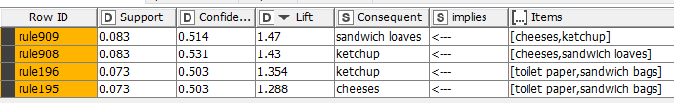
Recommendations
The Grocery store can provide some combo offers for eggs, ice creams, pasta, paper towels as they have a good 'Lift'.
They can also be thought of providing offers for the combo items bagels, cereals, sandwich bags, cheeses as they have a good ‘Lift’.
The store can provide a Buy 2 sandwich loaves and get 1 offer for either Cheese or Ketchup items.
Offer 10% discounts for toilet paper if they buy sandwich bags + cheese/ketchup. This is a lucrative offer where people always tends to buy this combination.

Slide 25

The store can offer a good combo meals in the below
combinations.
Individual meals & lunch meat with Ice cream.
Individual meals & lunch meat with Coffee/Tea.
Heavy meals for family like Sandwich loaves, lunch meat and
individual meals.

Slide 26
I’ve attached the KNIME workspace, excel and
provide you here the tableau public link as well.
https://public.tableau.com/app/profile/rifaz4445/viz/MarketBasket_16509474200510/YearoverYear?publish=yes

Slide 27
THANK YOU!

